Slide 1
TellCo User Analytics
By – Aryan Kashyap
Nexthikes IT Solutions

Slide 2
Executive Summary
106,856
customers
74.73%
low engagement
86.38%
main experience group
0.973
model R²
Most customers are in the low-engagement group, while a small group generates much higher activity.
Gaming and Other account for the largest application traffic volumes.
Network experience differs materially in throughput, RTT and TCP retransmission.
The constructed satisfaction score is sensitive to extreme network observations.
Data-only conclusion: the analysis identifies operational and growth opportunities; acquisition should be subject to financial and operational due diligence.
TellCo User Analytics | 2

Slide 3
Data & Methodology
Initial dataset: 150,000 records and 55 columns.
After preprocessing: 148,935 records and 63 columns.
Customer-level analysis: 106,856 unique customers.
Key domains: handset/device, application usage, engagement, network experience and satisfaction.
Methods: descriptive statistics, correlation analysis, PCA, K-Means clustering and Random Forest regression.
150k
raw records
148,935
cleaned
55 → 63
columns
106,856
customers
TellCo User Analytics | 3

Slide 4
Task 1 — Customer & Handset Overview
Huawei B528S-23A was the most frequently observed handset type (28,658 users).
Manufacturer counts: Apple 68,395; Samsung 40,579; Huawei 34,366.
Apple iPhone 6S and iPhone 6 were among the most frequent smartphone models.
A data-quality anomaly exists where Huawei B528S-23A appears under Apple for some records.
The anomaly was retained because the source data did not provide enough evidence for a reliable correction.
28,658
B528S-23A users
68,395
Apple users
40,579
Samsung users
TellCo User Analytics | 4

Slide 5
Task 1 — Usage Patterns & PCA
Session frequency correlates strongly with total traffic (r ≈ 0.81) and positively with duration (r ≈ 0.64).
Total traffic is extremely strongly correlated with gaming traffic (r ≈ 0.997).
PC1 explains 70.62% of variance; the first five PCs explain 90.86%.
PCA indicates substantial overlap among activity variables and a smaller set of underlying usage dimensions.
0.81
session ↔ traffic
0.997
traffic ↔ gaming
70.62%
PC1
90.86%
first 5 PCs
TellCo User Analytics | 5

Slide 6
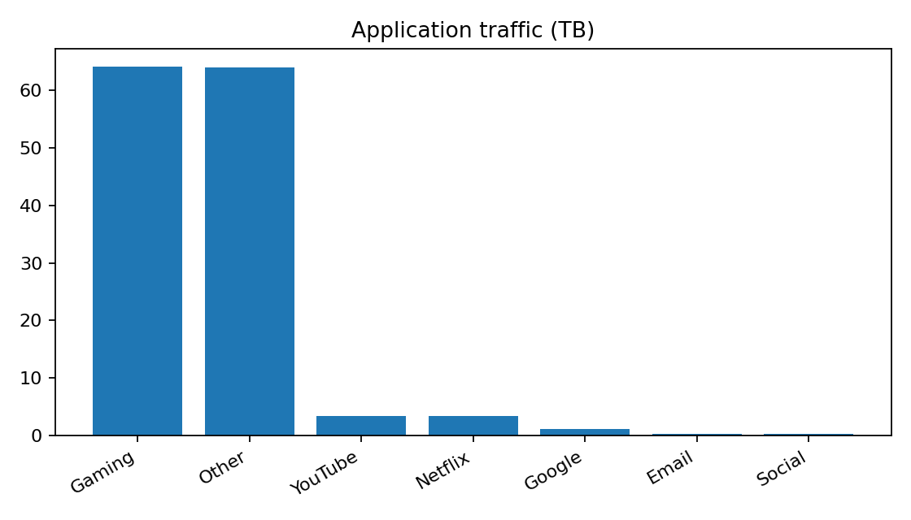
Task 2 — Application Traffic
Gaming: approximately 6.41 × 10¹³ bytes.
Other: approximately 6.40 × 10¹³ bytes.
YouTube and Netflix: approximately 3.37 × 10¹² bytes each.
Gaming is therefore a major traffic driver for capacity and service planning.
TellCo User Analytics | 6

Slide 7
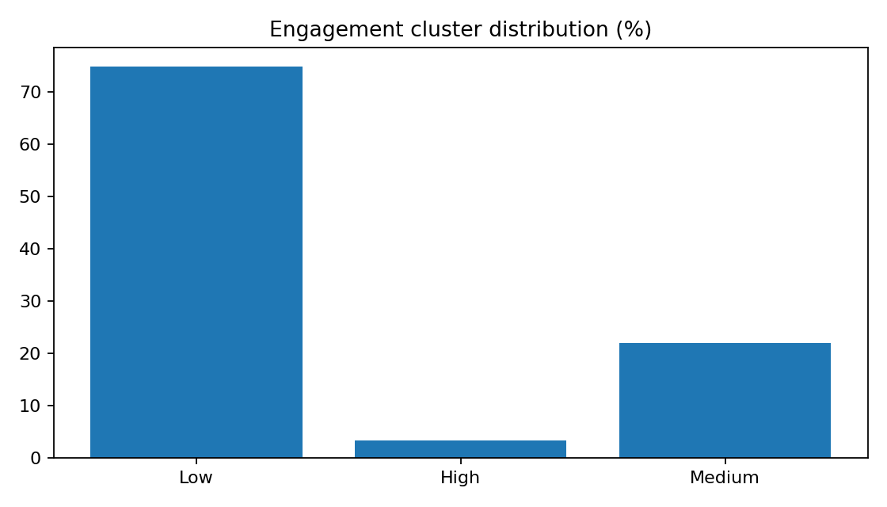
Task 2 — User Engagement Segmentation
K-Means (k=3) produced three engagement groups.
Low: 79,850 customers (74.73%).
High: 3,547 customers (3.32%), with the highest frequency, duration and traffic.
Medium: 23,459 customers (21.95%).
The customer base is dominated by light users, with a small intensive-use segment.
TellCo User Analytics | 7

Slide 8
Task 2 — Engagement Cluster Profiles
Group | Customers | Sessions | Duration ms | Traffic GB
Low | 79,850 | 1.03 | 103,121 | 0.495
Medium | 23,459 | 2.18 | 215,264 | 1.116
High | 3,547 | 4.41 | 658,229 | 2.292
The high-engagement segment is small but materially different in network activity.
The low-engagement segment is the largest population for understanding limited usage.
Top engaged customers are concentrated in the high-engagement cluster.
TellCo User Analytics | 8

Slide 9
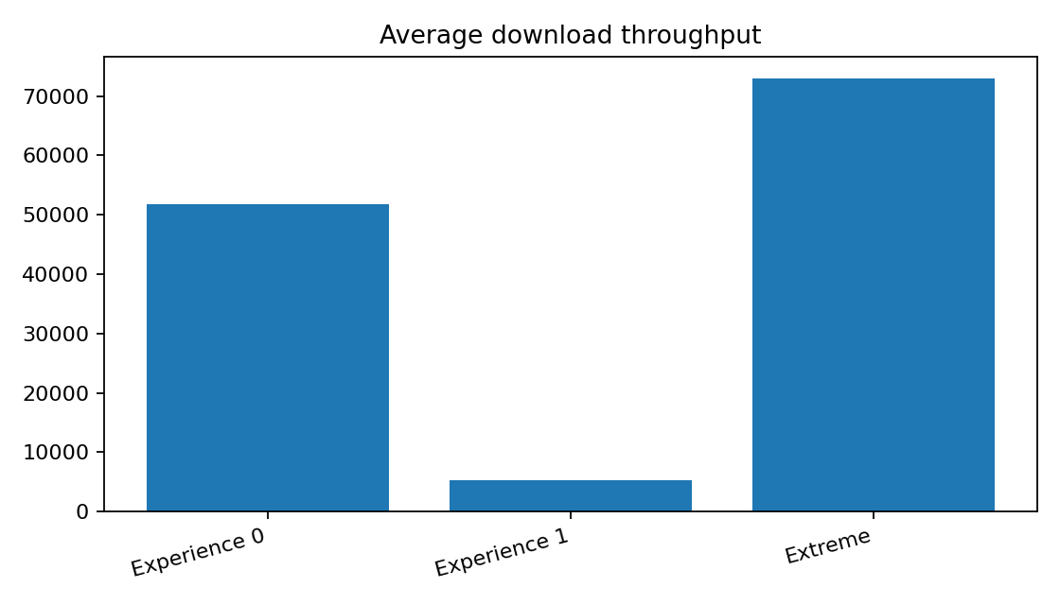
Task 3 — User Experience Segmentation
Cluster 1: 92,299 customers (86.38%); lowest throughput and relatively high download RTT.
Cluster 0: 14,553 customers (13.62%); higher throughput and lower download RTT, but higher download retransmission.
Cluster 2: only four customers, with exceptionally high upload retransmission.
The four-customer group should be treated as an extreme segment rather than a general experience cluster.
TellCo User Analytics | 9

Slide 10
Task 3 — Handset & Network Experience
Handset-level metrics show meaningful differences in throughput, RTT and retransmission.
Huawei B528S-23A has the largest handset user base and a distinct network-performance profile.
Several iPhone models show comparatively lower average download RTT than the B528S-23A group.
Handset-level monitoring can help distinguish device-specific patterns from broader network effects.
17,287
B528S-23A experience users
27,975
B528S-23A avg DL throughput
110.3 ms
B528S-23A avg DL RTT
TellCo User Analytics | 10

Slide 11
Task 4 — Satisfaction Score Construction
Engagement score = Euclidean distance from the less-engaged cluster.
Experience score = Euclidean distance from the selected worst general experience cluster.
Satisfaction score = average of engagement and experience scores.
Engagement Cluster 0 was used as the less-engaged baseline.
Experience Cluster 1 was used as the worst general baseline; the four-customer extreme cluster was not used as the representative baseline.
Higher scores mean greater distance from the selected low-engagement / poor-experience reference point.
TellCo User Analytics | 11

Slide 12
Task 4 — Top Satisfaction Scores
Rank | Customer ID | Score
1 | 3.376359e10 | 98.849
2 | 3.366232e10 | 83.912
3 | 3.366470e10 | 70.803
4 | 3.366509e10 | 69.690
5 | 3.366905e10 | 54.948
6 | 3.362578e10 | 51.320
7 | 3.365978e10 | 48.647
8 | 3.368369e10 | 47.497
9 | 3.363330e10 | 38.298
10 | 3.376109e10 | 36.964
Top scores are heavily influenced by the experience-distance component.
Several of the top five are among the four extreme experience observations.
The constructed score is therefore sensitive to extreme network measurements.
Use as a relative analytical segmentation, not a direct survey-based satisfaction measure.
TellCo User Analytics | 12

Slide 13
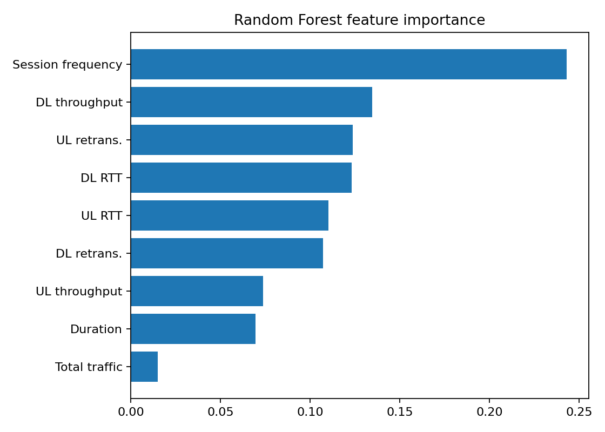
Task 4 — Satisfaction Prediction Model
0.220
RMSE
0.973
R²
Random Forest Regressor with 100 trees.
Session frequency was the most important feature (≈0.243).
Throughput, retransmission and RTT metrics were also important.
High R² means strong reproduction of the constructed score, not independent measurement of real customer satisfaction.
TellCo User Analytics | 13

Slide 14
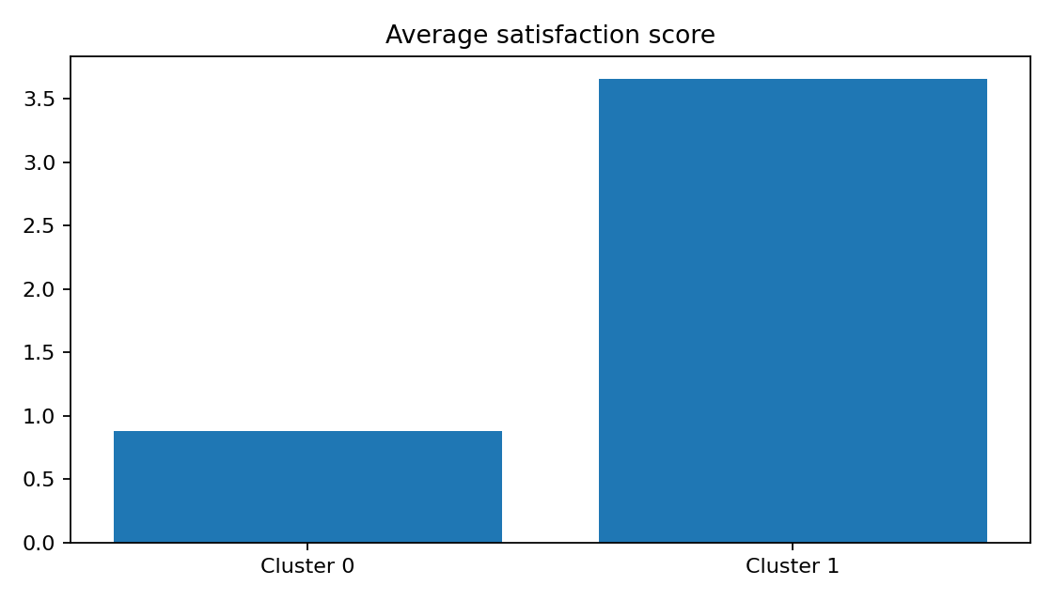
Task 4 — Satisfaction Clustering
K-Means (k=2) was applied to standardized engagement and experience scores.
Cluster 0: 99,115 customers (92.76%), average satisfaction 0.880.
Cluster 1: 7,741 customers (7.24%), average satisfaction 3.653.
Cluster 1 also has higher average engagement score (4.875) and experience score (2.431).
Cluster labels are arbitrary; interpret using the actual score values.
TellCo User Analytics | 14

Slide 15
Task 4 — MySQL Export & Model Tracking
106,856
rows exported
4
final score fields
100
Random Forest trees
Final table: customer ID, engagement score, experience score and satisfaction score.
MySQL database: telecom_project; table: customer_satisfaction.
Row count and sample records were verified after import.
Model tracking JSON records model configuration, features, target and evaluation metrics.
Lightweight local tracking was used; Docker, CI/CD and unit tests were not required for this implementation.
TellCo User Analytics | 15

Slide 16
Business Implications
Investigate the large low-engagement population to understand barriers to deeper usage.
Monitor the small high-engagement population because it generates disproportionately high activity.
Include gaming/application mix in network-capacity planning.
Prioritize throughput, RTT and retransmission analysis for network optimization.
Use handset-level experience metrics to identify device-specific patterns.
Investigate the four extreme experience observations separately before applying broad customer actions.
TellCo User Analytics | 16

Slide 17
Investment View & Limitations
Recommendation: proceed to the next stage of due diligence rather than making an acquisition decision from xDR data alone.
The analysis identifies measurable growth and optimization opportunities, but financial performance, revenue, churn, costs and network investment requirements must also be validated.
Only one month of data is analyzed, so seasonality and longer-term behavior are not captured.
The satisfaction score is a constructed distance-based proxy and is sensitive to extreme observations.
Correlation and model feature importance show association/model reliance, not causation.
Handset/manufacturer inconsistencies may affect some device-level conclusions.
TellCo User Analytics | 17

Slide 18
Final Takeaway
TellCo's customer base shows clear differences in engagement and network experience.
A small intensive-use group drives substantially higher activity, while most customers show lower engagement.
Gaming is a major traffic contributor and network-quality metrics reveal clear experience segmentation.
The data supports targeted growth and network-optimization opportunities.
Combine these findings with financial and operational due diligence before any purchase decision.

Slide 19
THANK YOU

